Slide 1
Space Wars
A sci-fi space multiplayer arena brawl
Presented by Brandon Lauer & Roberto Di Biase

Slide 2
Background
Purpose / Problems solved
Provide players with an action packed online multiplayer experience where they battle other players using power-ups and barriers to determine who is the champion.
Allow the player to Register or Login in order to play and buy weapons from the Shop.

Slide 3

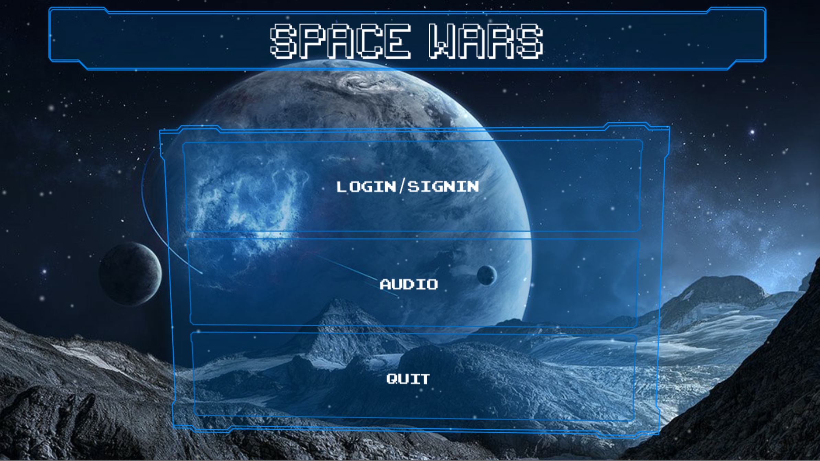
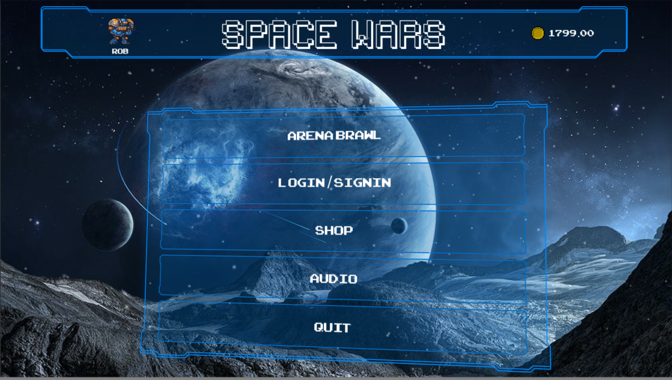
Solution overview

Slide 4
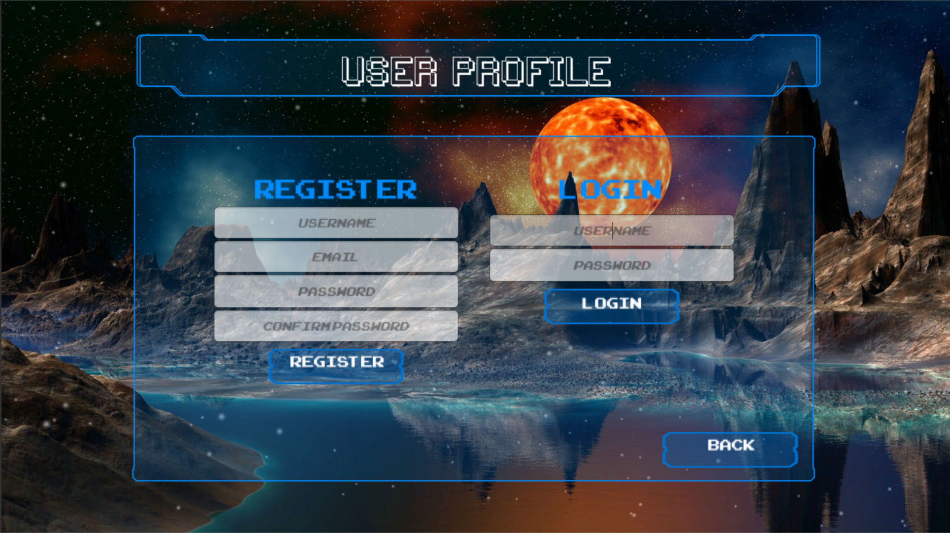

Slide 5
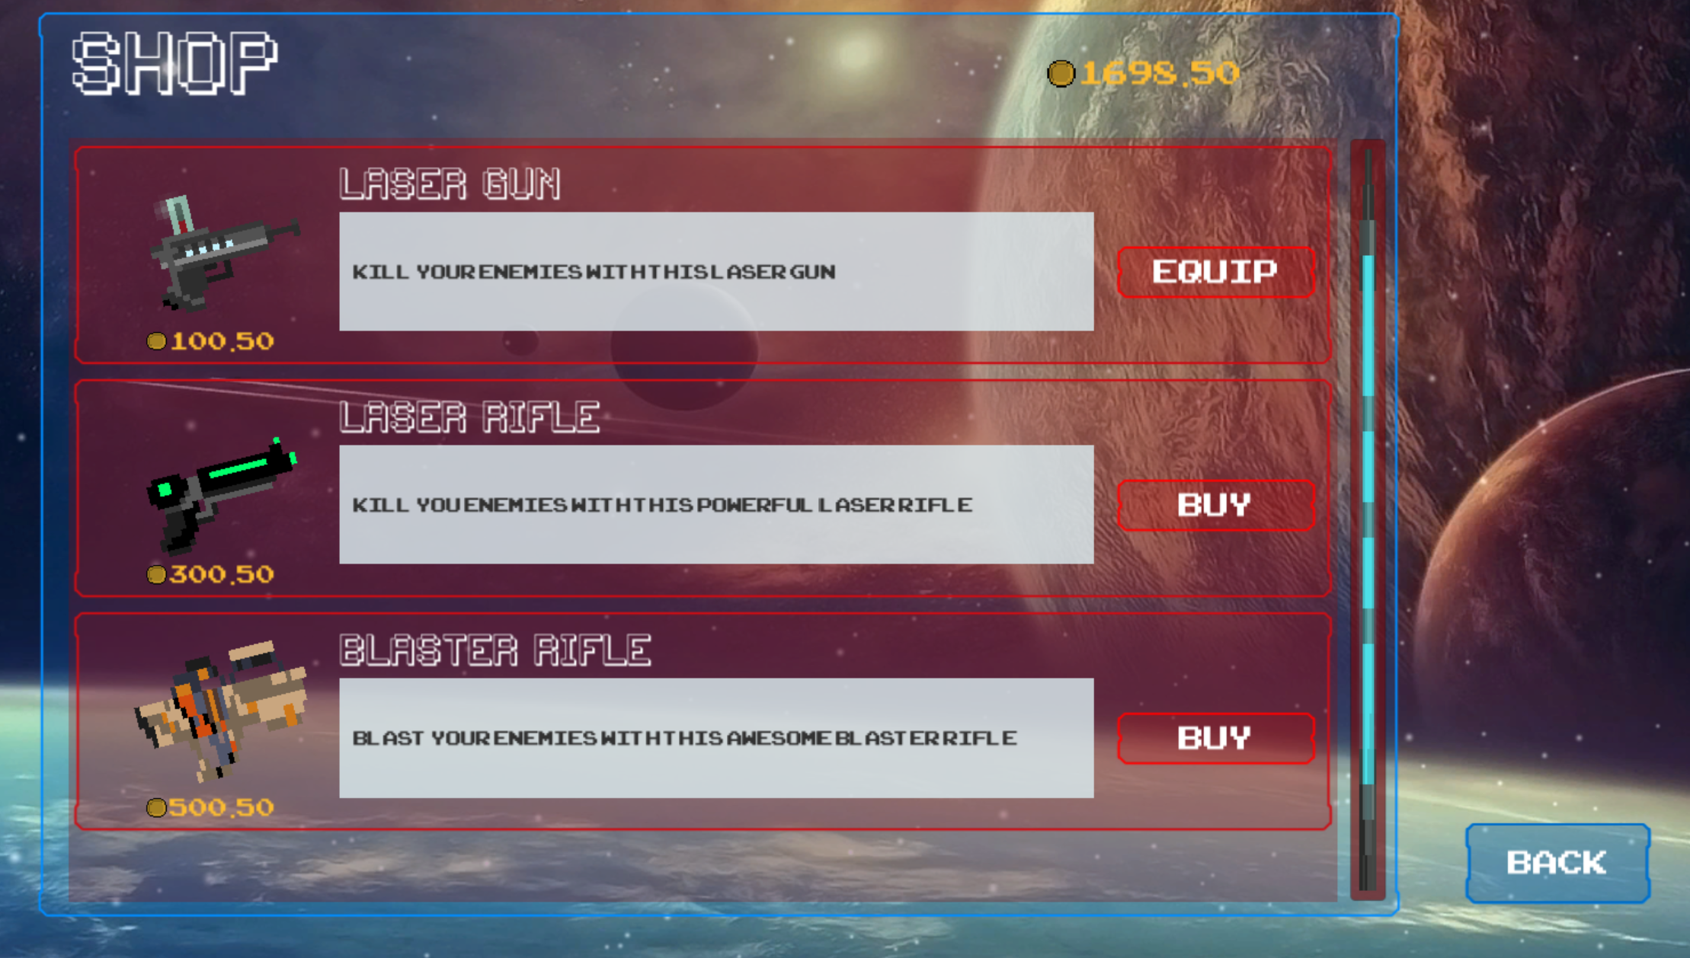

Slide 6
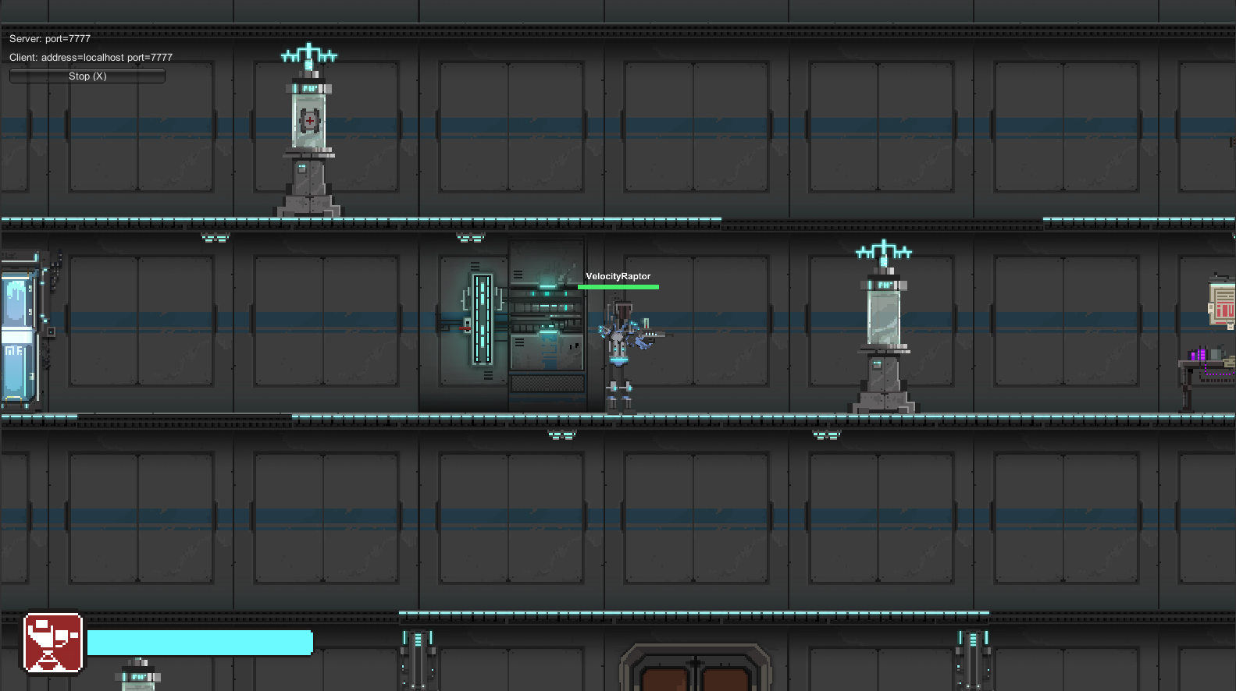

Slide 7
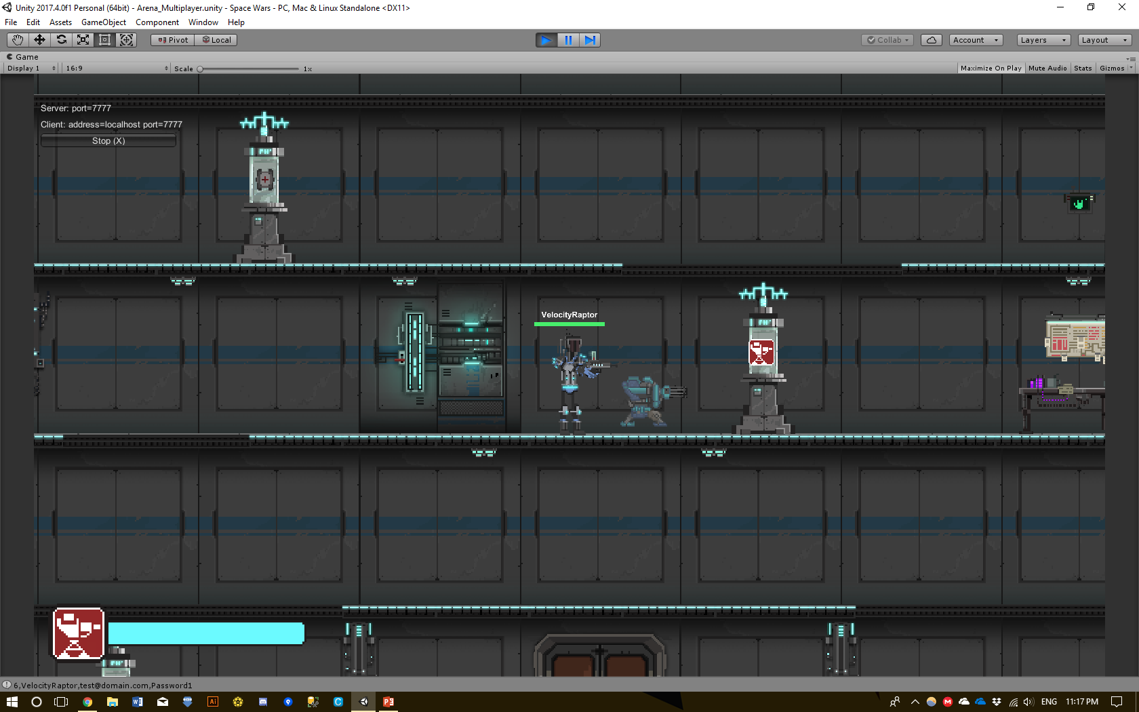
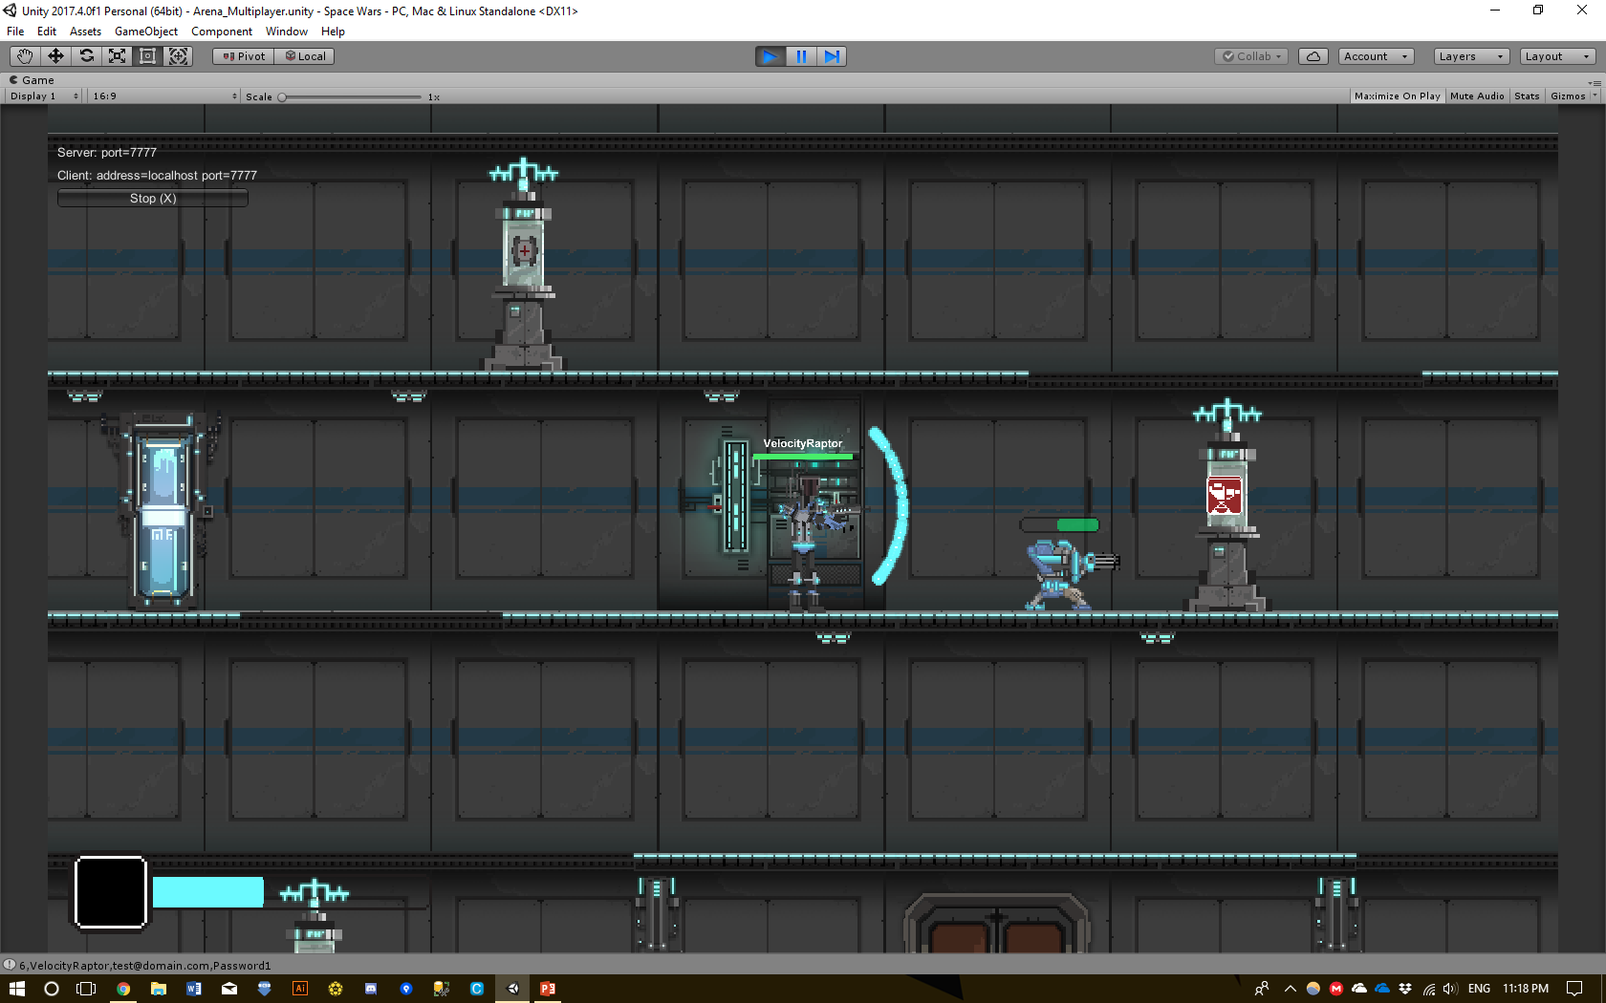

Slide 8
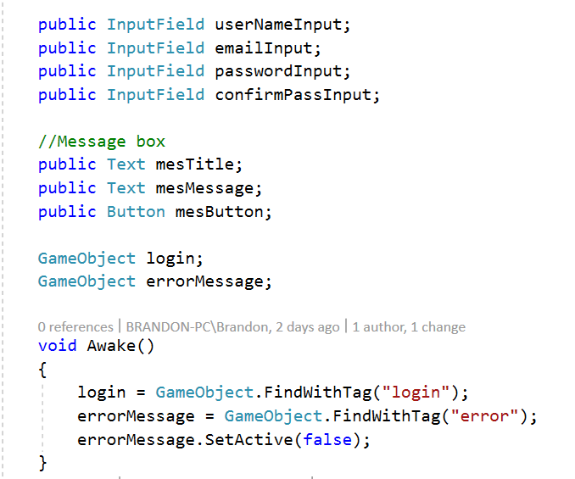
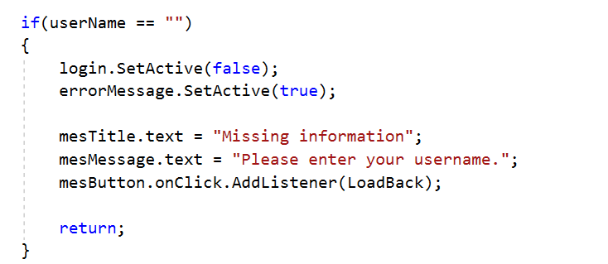
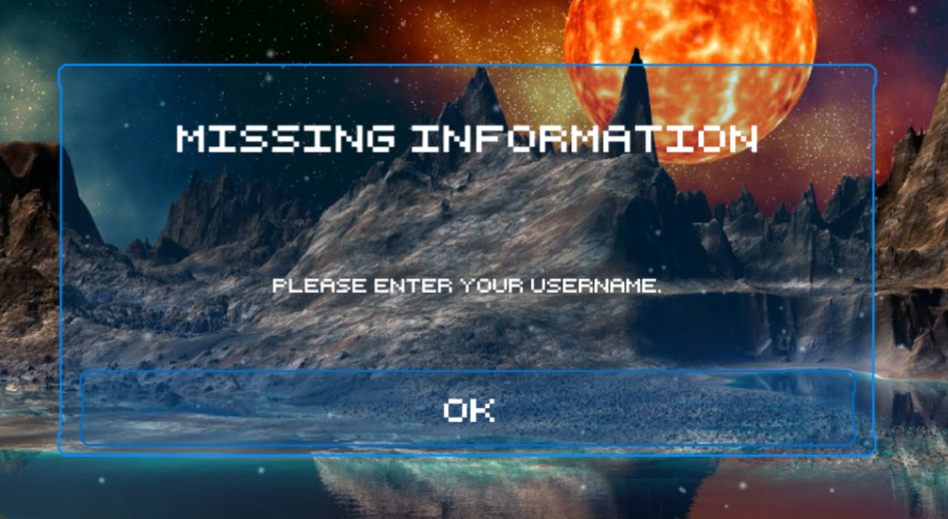
Challenges / What we learned
1. Display error messages in game

Slide 9
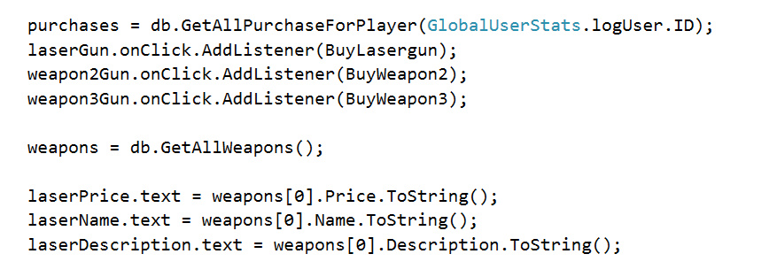
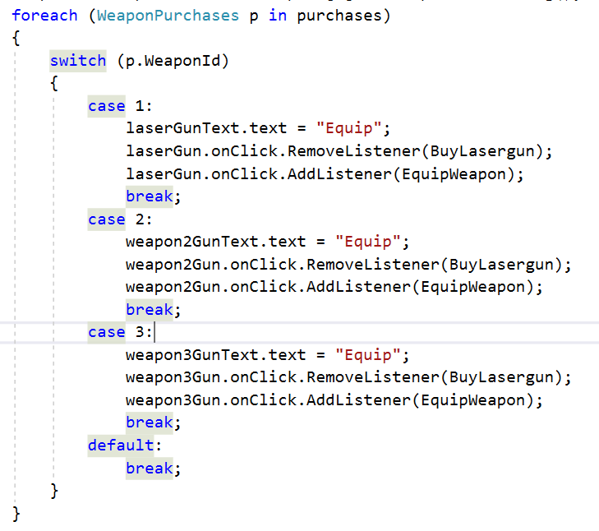
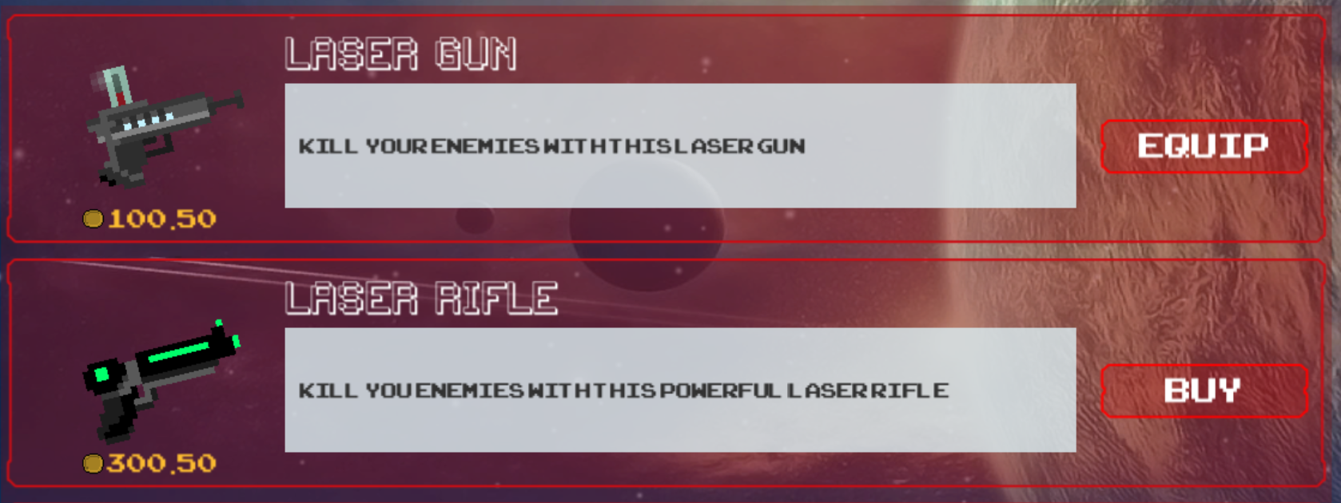
2. Use the same button to Buy and Equip weapons

Slide 10
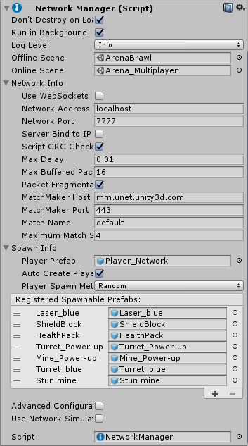
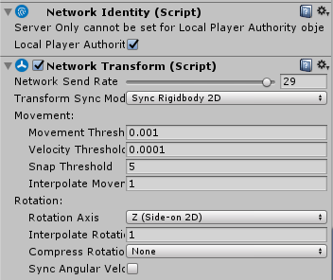
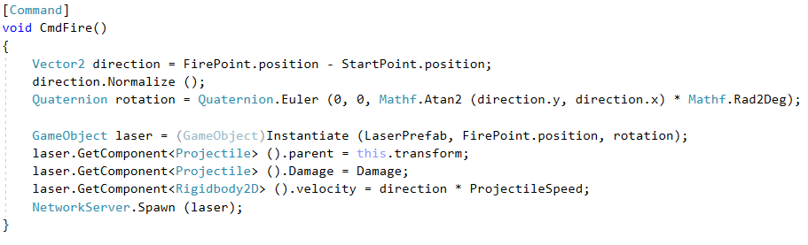
Multiplayer

Slide 11
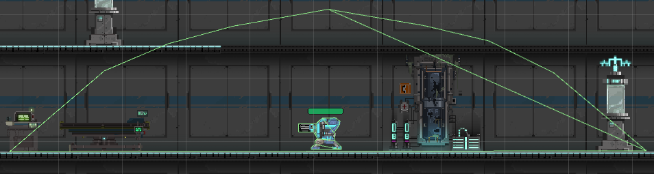
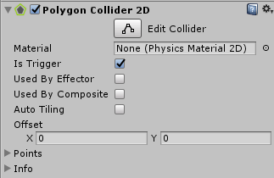
Auto-Turret Target locking

Slide 12
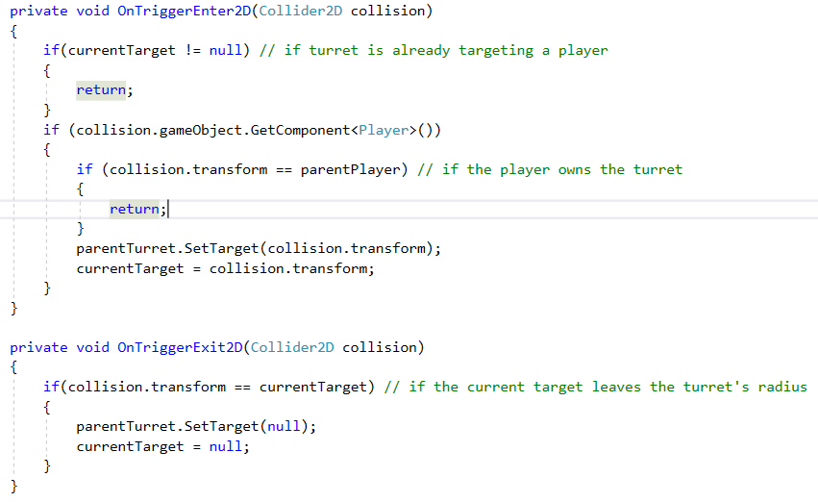

Slide 13
LIVE DEMO

Slide 14
Future work
Add a Survival Co-op mode with waves of enemies
Implement an in-game Menu
Personalized multiplayer HUD
More power-ups and laser blasters
Different player skins

Slide 15
Summary
Features in our Game:
Main menu with audio settings
Login and Registration menu
Shop connected to database
Multiplayer online Arena Brawl game mode
Shield blocks
Stun mine and auto-turret power-ups

